Slide 1

Budget Bond
Name :- Sairaj Kulkarni, EjazAhmad Sayyed, Hardik Dhamnaskar.
Guide Name :- Dr. Rahat Khan

Slide 2
Index
Abstract
Introduction
Problem Statement
Aim
Tech Stack
Flowcharts
Conclusion

Slide 3
Abstract
This project suggests a web-based budget managing tool which will boost financial consciousness and responsibilities between the parent and the dependent(s). This tool aims to allow the parent not only to assign a certain budget amount to the dependent(s) but also to monitor in real-time the expenditure of the dependent(s). He/she will also be aware of his/her balance.
Both will have separate login modules in the app, which will include a parent and a dependent dashboard. There will be graphical representation tools on how to make expenses using pie charts and bar graphs. The budget limit will be imposed by means of validating the input values into the tool. This project is a real-life usage of web-related technologies.

Slide 4

Introduction
The management of one’s finances is a crucial aspect in life, particularly among young people. Unfortunately, the dependents may not have any systematic approach for tracking their spending, whereas the parents may not be able to determine how the money they allocate has been spent.
Here, a web application comes in handy, whereby the user will get a platform that makes the process easy by allowing parents to budget and monitor expenses, and at the same time teaching dependents the right way to handle their finances.

Slide 5
Problem Statement
Current techniques of managing allowances have limitations with respect to control and monitoring. It is difficult for parents to monitor and manage the spending of funds, and the dependents frequently exceed their allotted budget.
A solution to this problem is needed:
Ensures immediate tracking of expenses
Implement budget constraints
Provides visual representation of spending
Establishes an organized structure between the parent and dependent positions

Slide 6

Aim
Develop a web-based budget management system that will help parents distribute budgets and supervise them as well as give their dependents the opportunity to control and document their spending.
a. Objective
Dual Login System with Role-Based Dashboard
Budget Assignment and Control by Parents
Expense Tracking and Classification by Dependents
Graphical Representation of Spending
Financial Discipline Enforcement Through Budget Limits
b. Scope
This software solution aims to assist families in managing their finances, especially those related to parents and dependents. It might also be applicable to other scenarios such as personal finance applications or even budget management software solutions for students.

Slide 7
Technology Stack
Frontend: HTML, CSS, JavaScript, React
Backend: Node.js with Express.js
Database: MongoDB
Visualization: Chart.js
Development Tools: VS Code, Git
Frontend: HTML, CSS, JavaScript, React
Backend: Node.js with Express.js

Slide 8
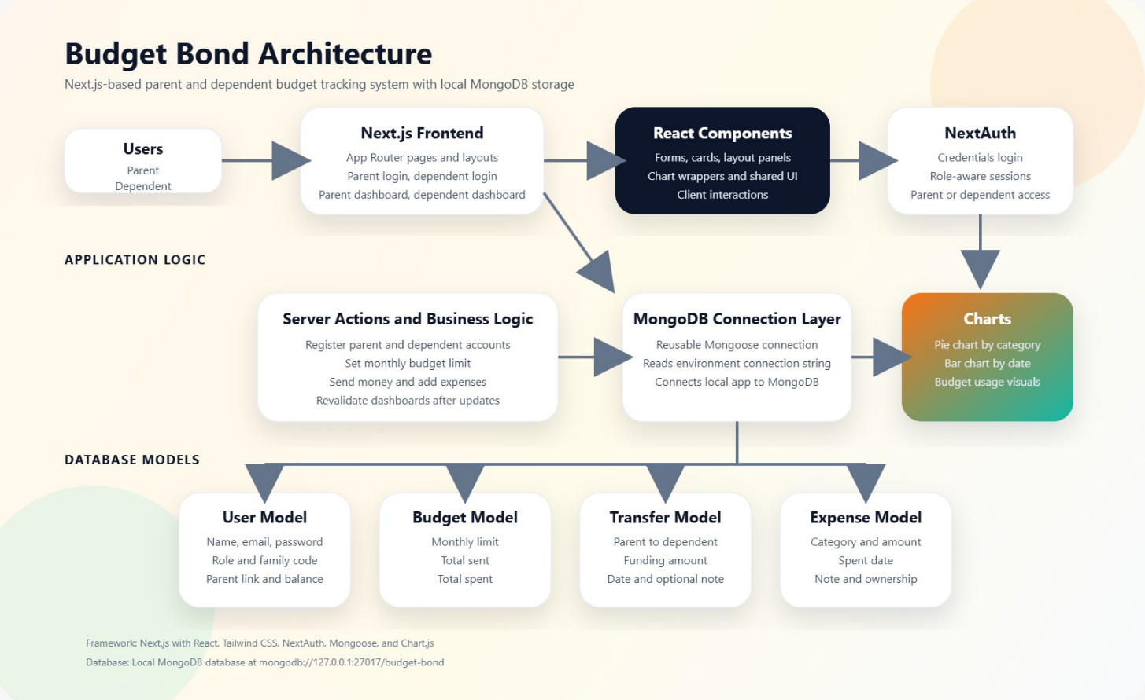
Flowcharts
Architecture of Project

Slide 9
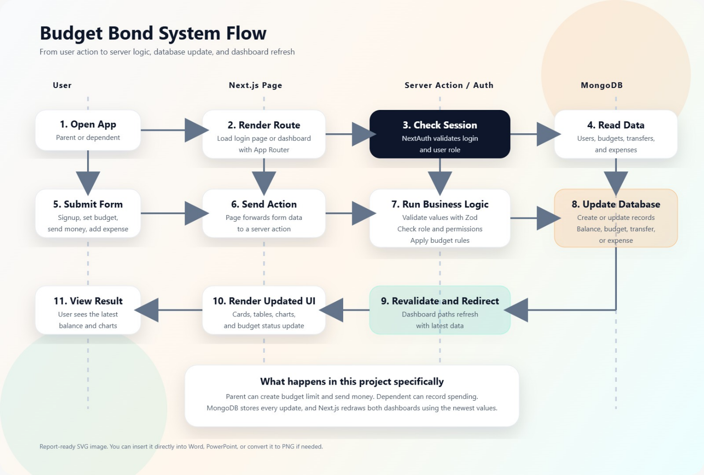
Workflow of Project

Slide 10
Conclusion
Regarding the issue at hand unstructured and unauthorized spending between parents and dependents the developed solution is highly effective. Using budget management, expenses tracking, limits enforcement, and monitoring capabilities, the proposed solution helps resolve the identified problem efficiently and effectively. To ensure the success of the developed Budget Management Web Application, it includes separate dashboards for parents and dependents, respectively. Finally, the chosen stack of technologies used for its development allows one to highlight full-stack programming skills acquired while creating the project, including HTML5, CSS3, JS + React frontend development framework, as well as Node.js and Express.js and MongoDB backend development technologies.

Slide 11
Thank You…

